Slide 1

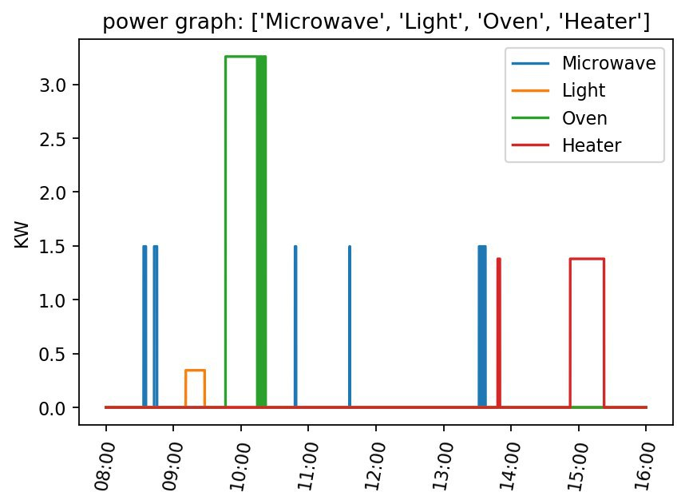
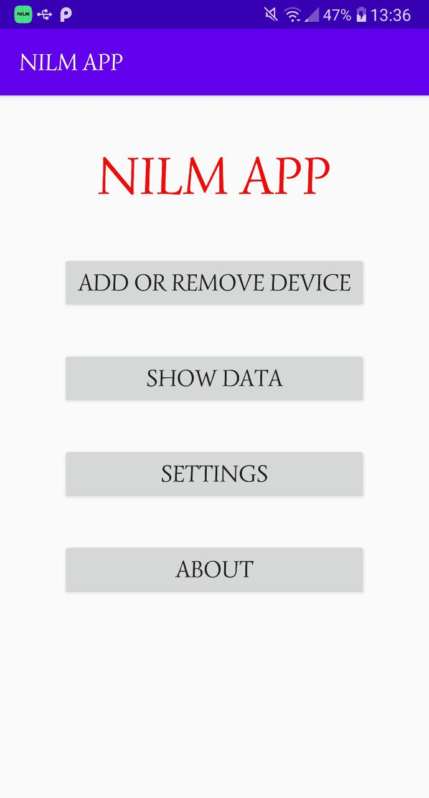
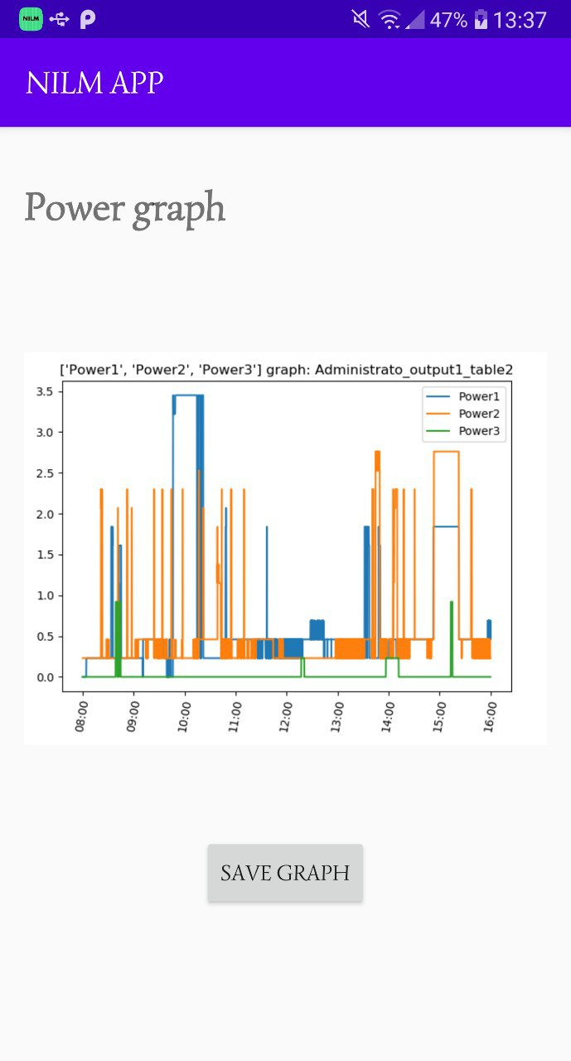
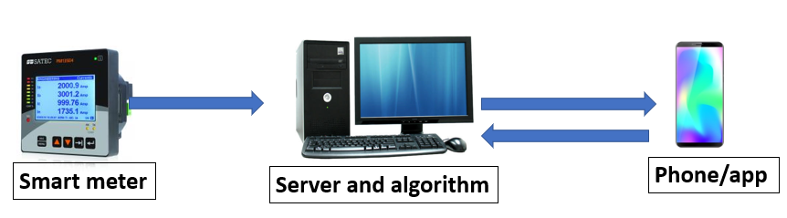
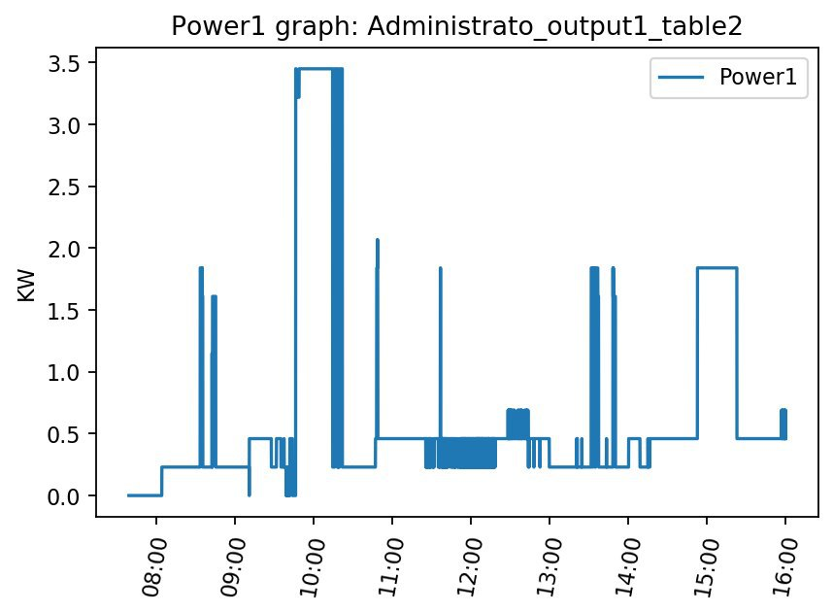

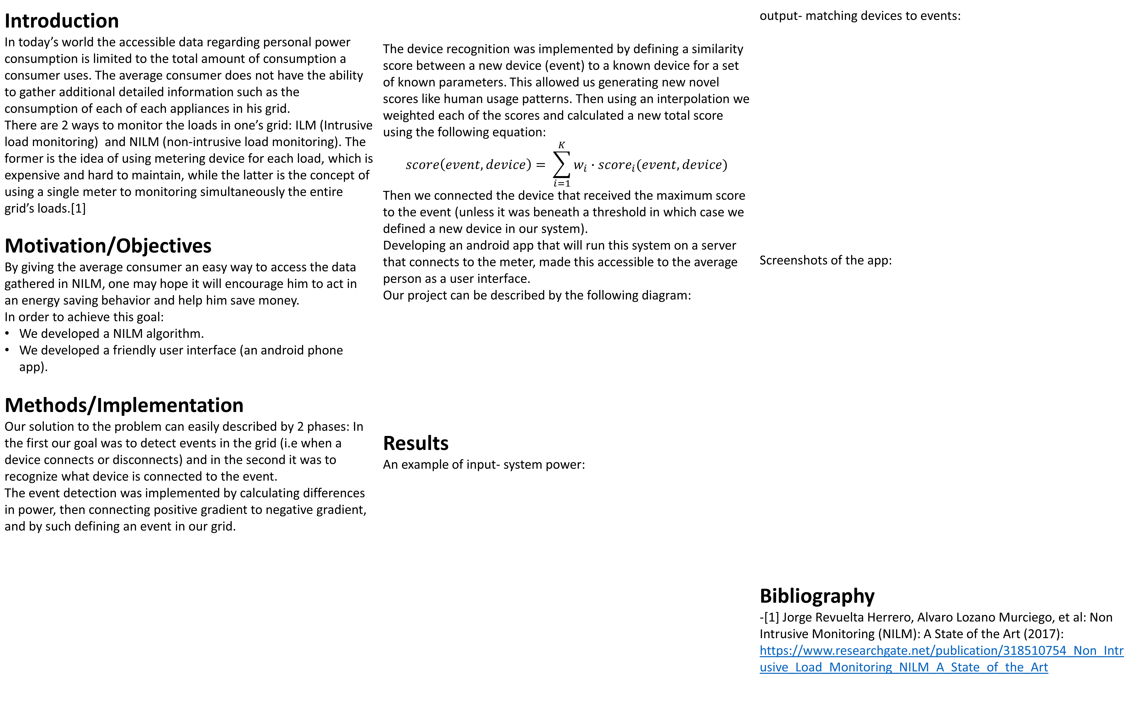
NILM in Smart Grids
Project Number: 19-1-1-1950
Names: Matan Matzliach and Alon Satchi
Advisor: Dr. Yuval Beck
Introduction In today’s world the accessible data regarding personal power consumption is limited to the total amount of consumption a consumer uses. The average consumer does not have the ability to gather additional detailed information such as the consumption of each of each appliances in his grid. There are 2 ways to monitor the loads in one’s grid: ILM (Intrusive load monitoring) and NILM (non-intrusive load monitoring). The former is the idea of using metering device for each load, which is expensive and hard to maintain, while the latter is the concept of using a single meter to monitoring simultaneously the entire grid’s loads.[1] Motivation/Objectives By giving the average consumer an easy way to access the data gathered in NILM, one may hope it will encourage him to act in an energy saving behavior and help him save money. In order to achieve this goal: We developed a NILM algorithm. We developed a friendly user interface (an android phone app). Methods/Implementation Our solution to the problem can easily described by 2 phases: In the first our goal was to detect events in the grid (i.e when a device connects or disconnects) and in the second it was to recognize what device is connected to the event. The event detection was implemented by calculating differences in power, then connecting positive gradient to negative gradient, and by such defining an event in our grid. | The device recognition was implemented by defining a similarity score between a new device (event) to a known device for a set of known parameters. This allowed us generating new novel scores like human usage patterns. Then using an interpolation we weighted each of the scores and calculated a new total score using the following equation: $$score\left(event,device\right)= \sum_{i=1}^{K}{w_{i}∙score_{i}(event,device)}$$ Then we connected the device that received the maximum score to the event (unless it was beneath a threshold in which case we defined a new device in our system). Developing an android app that will run this system on a server that connects to the meter, made this accessible to the average person as a user interface. Our project can be described by the following diagram: Results An example of input- system power: | output- matching devices to events: Screenshots of the app: Bibliography -[1] Jorge Revuelta Herrero, Alvaro Lozano Murciego, et al: Non Intrusive Monitoring (NILM): A State of the Art (2017): https://www.researchgate.net/publication/318510754_Non_Intrusive_Load_Monitoring_NILM_A_State_of_the_Art

